Slide 1
smartgrid with DeepQ(ppt)
smartgrid with DeepQ

Slide 2
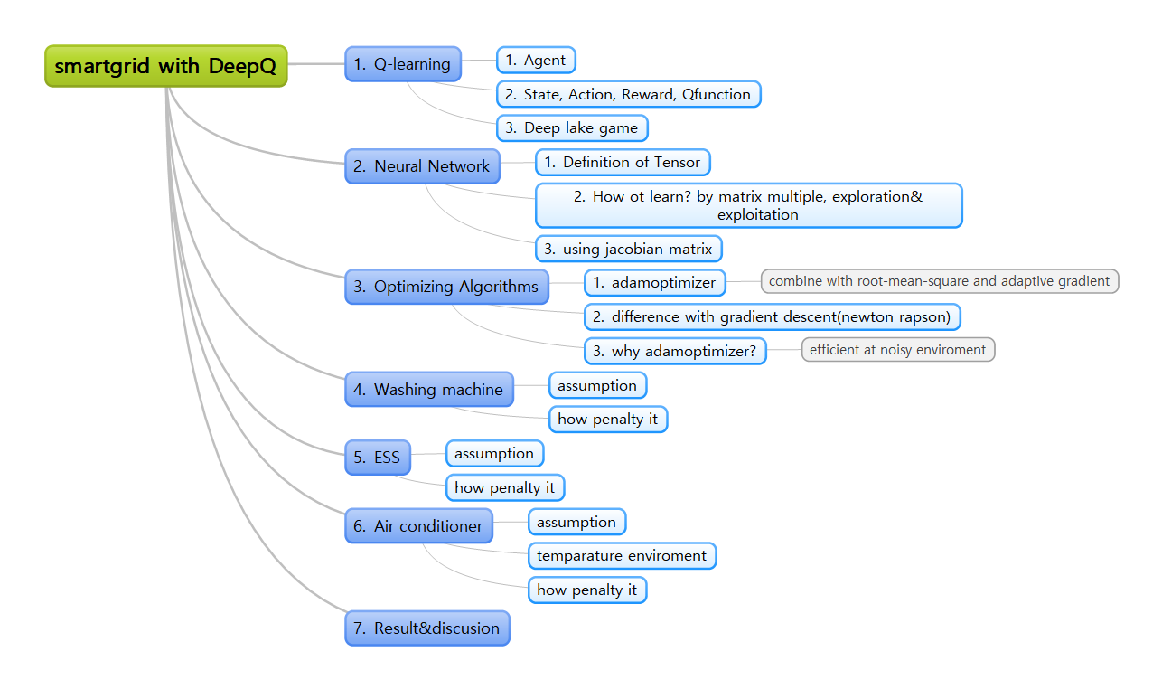
Overview

Slide 3
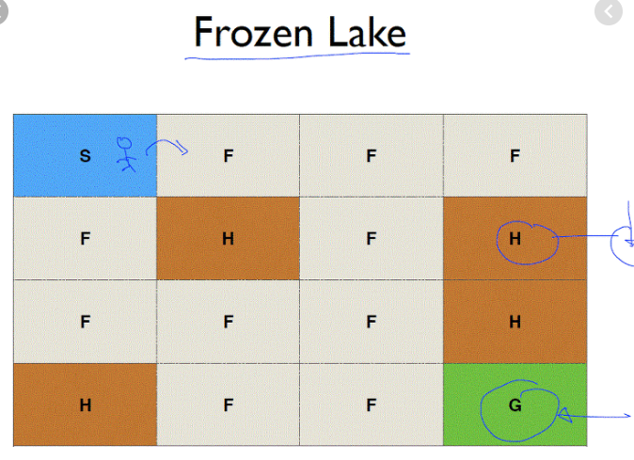
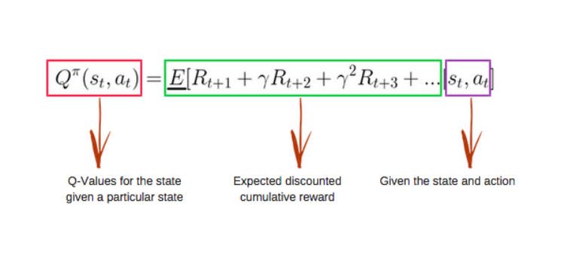
Q-learning
Agent
State, Action, Reward, Qfunction
Deep lake game

Slide 4
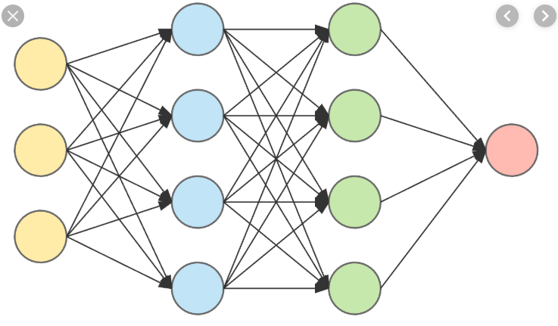
Neural Network
Definition of Tensor
How ot learn? by matrix multiple, exploration& exploitation
using jacobian matrix

Slide 5
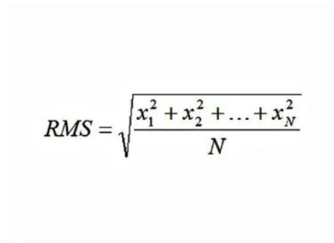
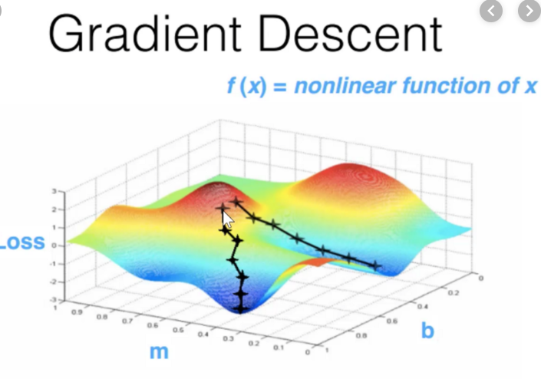
Optimizing Algorithms
adamoptimizer
  combine with root-mean-square and adaptive gradient
difference with gradient descent(newton rapson)
why adamoptimizer?
  efficient at noisy enviroment

Slide 6
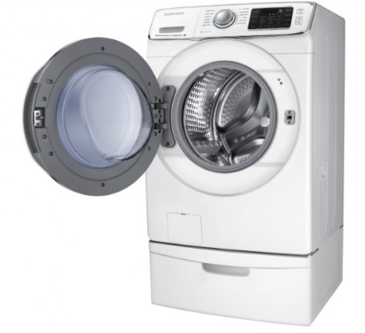
Washing machine
assumption
how penalty it

Slide 7
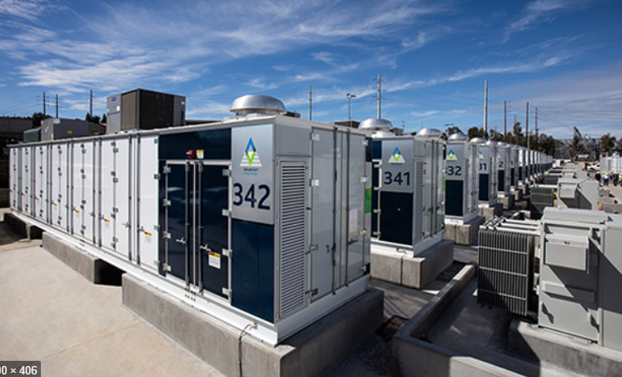
ESS
assumption
how penalty it

Slide 8

Air conditioner
assumption
temparature enviroment
how penalty it

Slide 9
Why we choose these three machines?
These machines are vey sensitive for power price in time domain
Once these machine`s work, these machines work at least one hour(it`s easy to calculate it`s reward)
Ess is key element in smartgrid

Slide 10
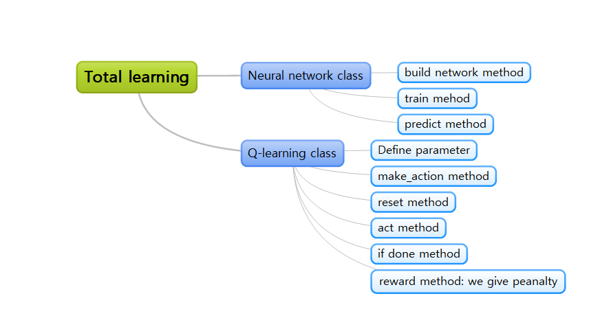
Then, how to build it? –using python and tensorflow(1)
Algorithm of these deep-Q

Slide 11
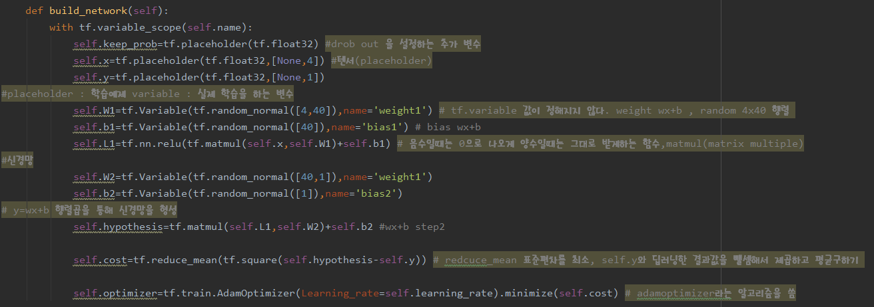
Then, how to build it? –using python and tensorflow(2)
Neural network class – build network method

Slide 12
Then, how to build it? –using python and tensorflow(3)
Train method

Slide 13
Then, how to build it? –using python and tensorflow(4)
Predict method

Slide 14
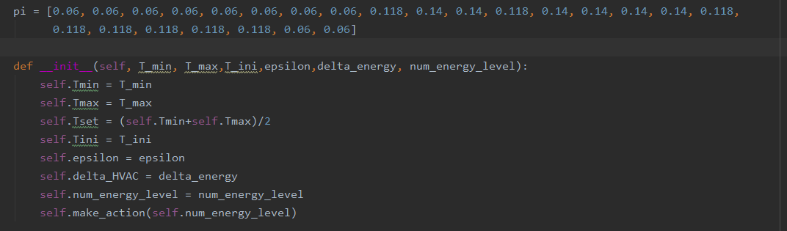
Then, how to build it? –using python and tensorflow(5)
Define parameters

Slide 15
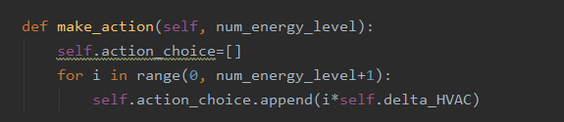
Then, how to build it? –using python and tensorflow(6)
Make_action method

Slide 16
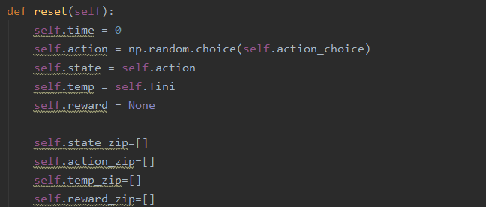
Then, how to build it? –using python and tensorflow(7)
Reset method

Slide 17
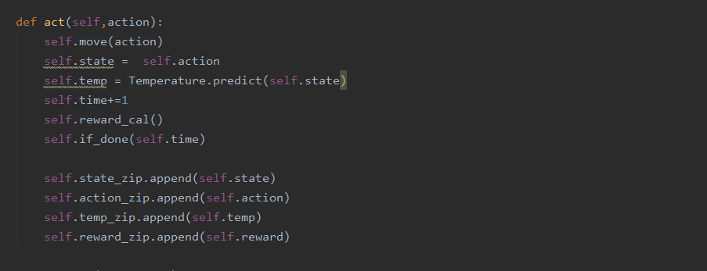
Then, how to build it? –using python and tensorflow(8)
Act method

Slide 18
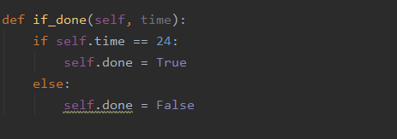
Then, how to build it? –using python and tensorflow(9)
If done method

Slide 19
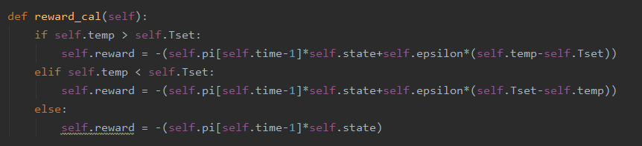
Then, how to build it? –using python and tensorflow(10)
Reward method : we give penalty

Slide 20
Result&discusion

